Slide 1


Satisfaction of life in Benin

Slide 2

Strongly associated to the national per Capita income
Individuals are more likely to be satisfied with their personal situation
What is Life Satisfaction

Slide 3
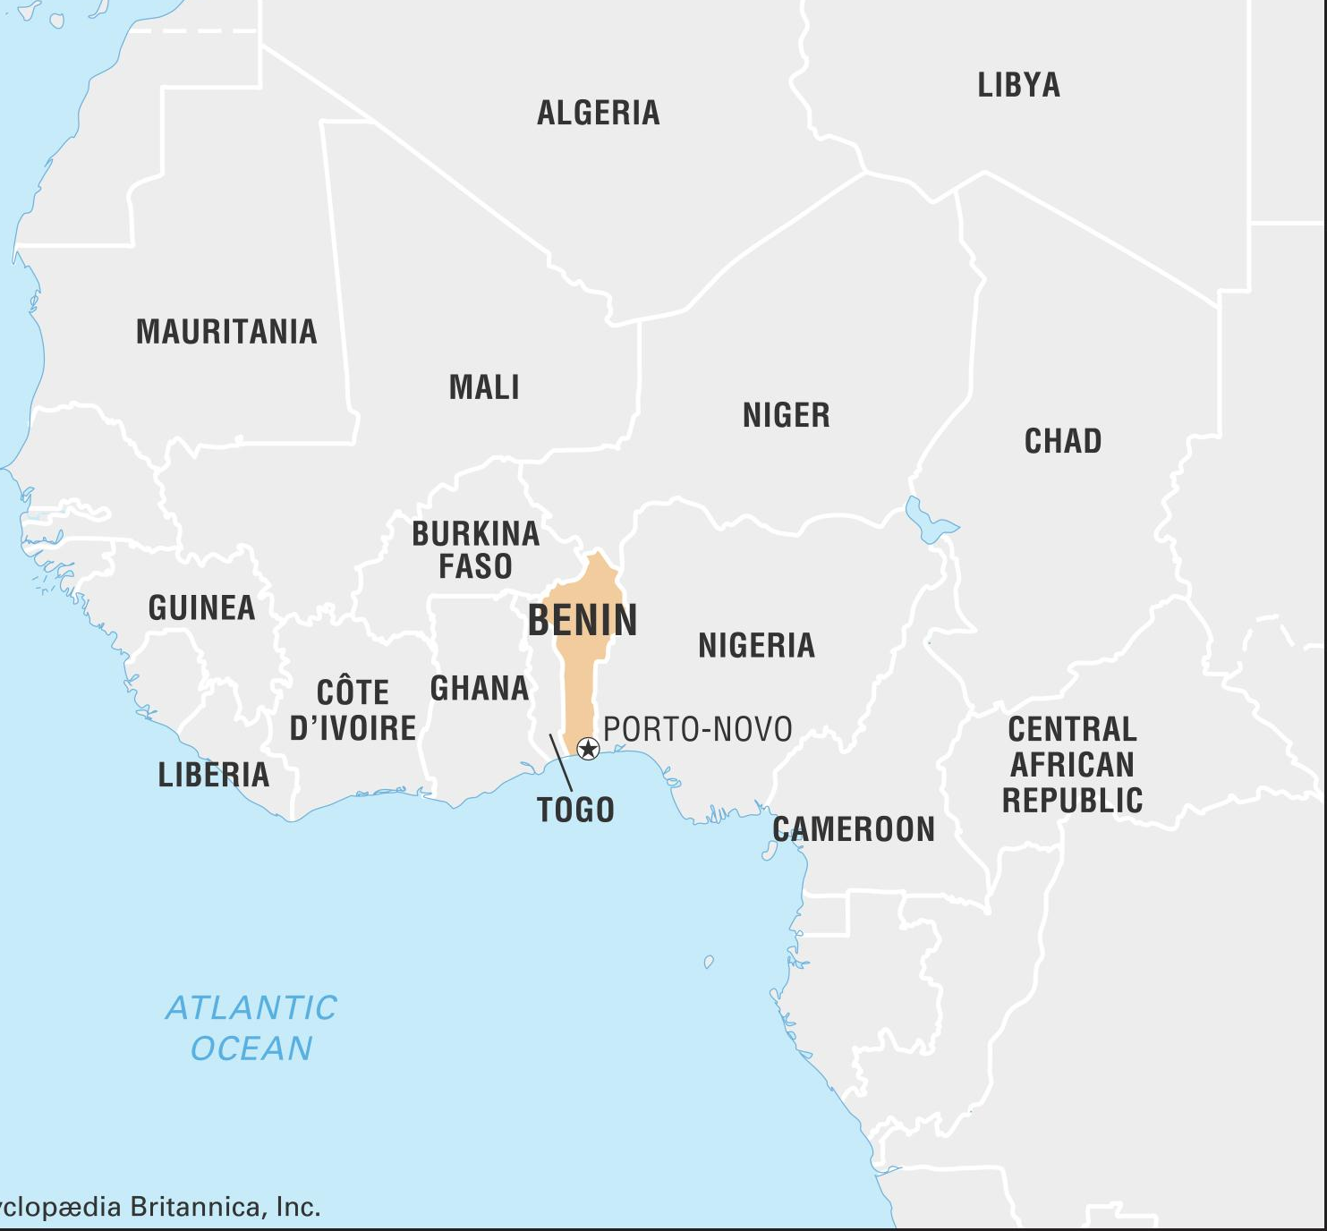
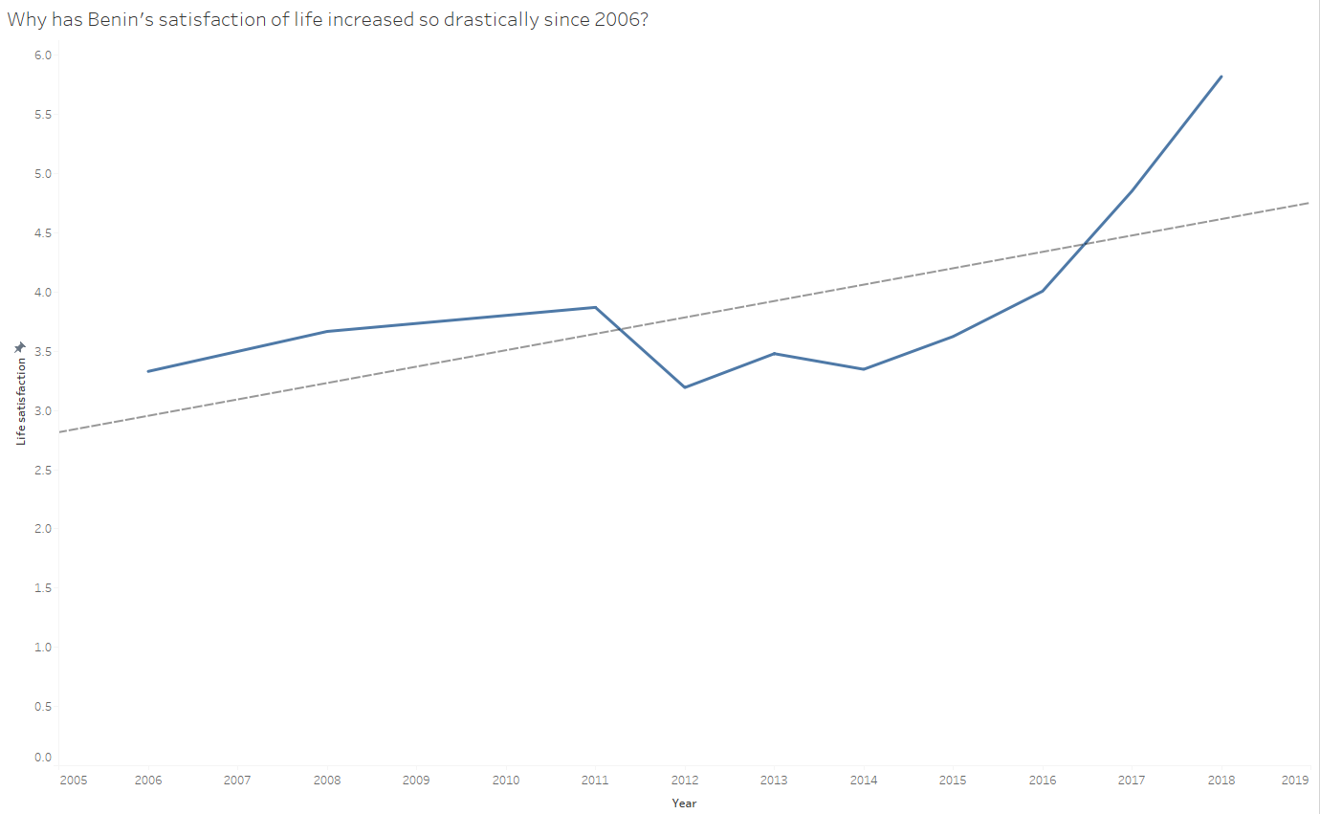

Let's look at Benin

Slide 4


More about Benin
Why has Benin Doubled in its life satisfaction and on average has increased the quickest out of every location included in the dataset?

Slide 5

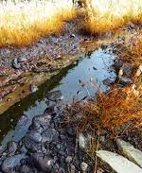
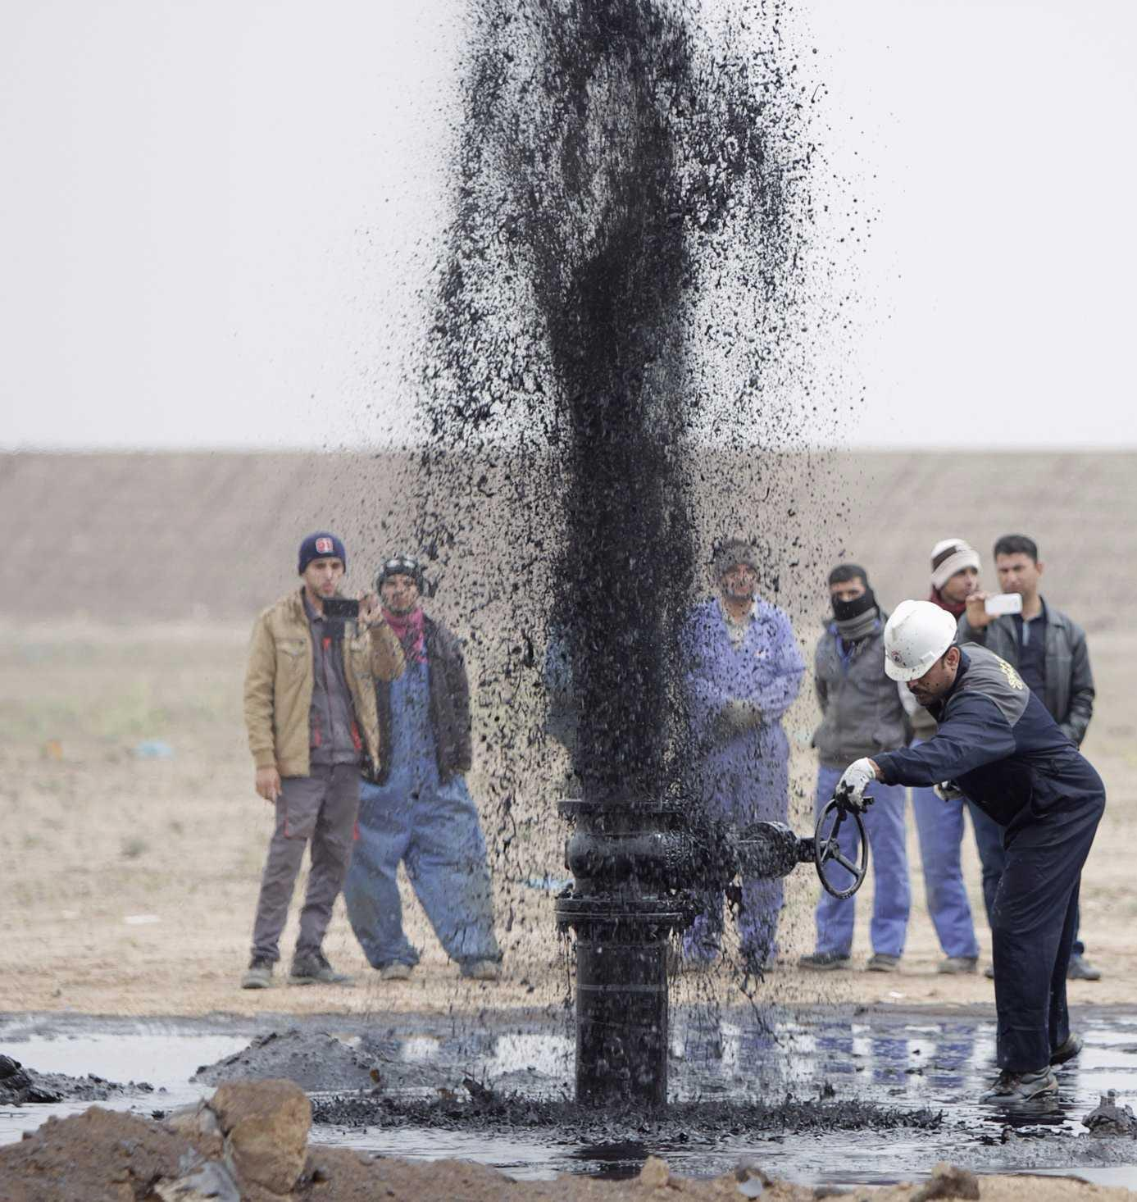
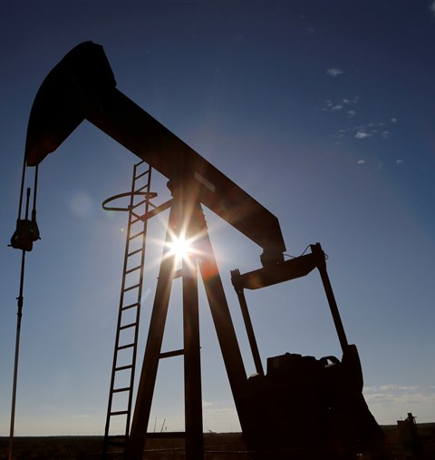






Oil!

Slide 6
H
In 2009 they found oil but was not able to utilize their finds since they were amidst a governmental crisis. It wasn't until President Yayi’s party was able to reign control over parliament in 2011 were they able to start to using the oil they found. Since then, their National per capita income has increased drastically, hence their life satisfaction has as well.

Slide 7
LATCH
I not only used Location but also Time! I used Location to tell you a story of Benin. I also used Time to tell you a story of Benin from 2006 - 2018.

Slide 8


This Presentation is Prepared by
“Noah Foilb”

